Slide 1
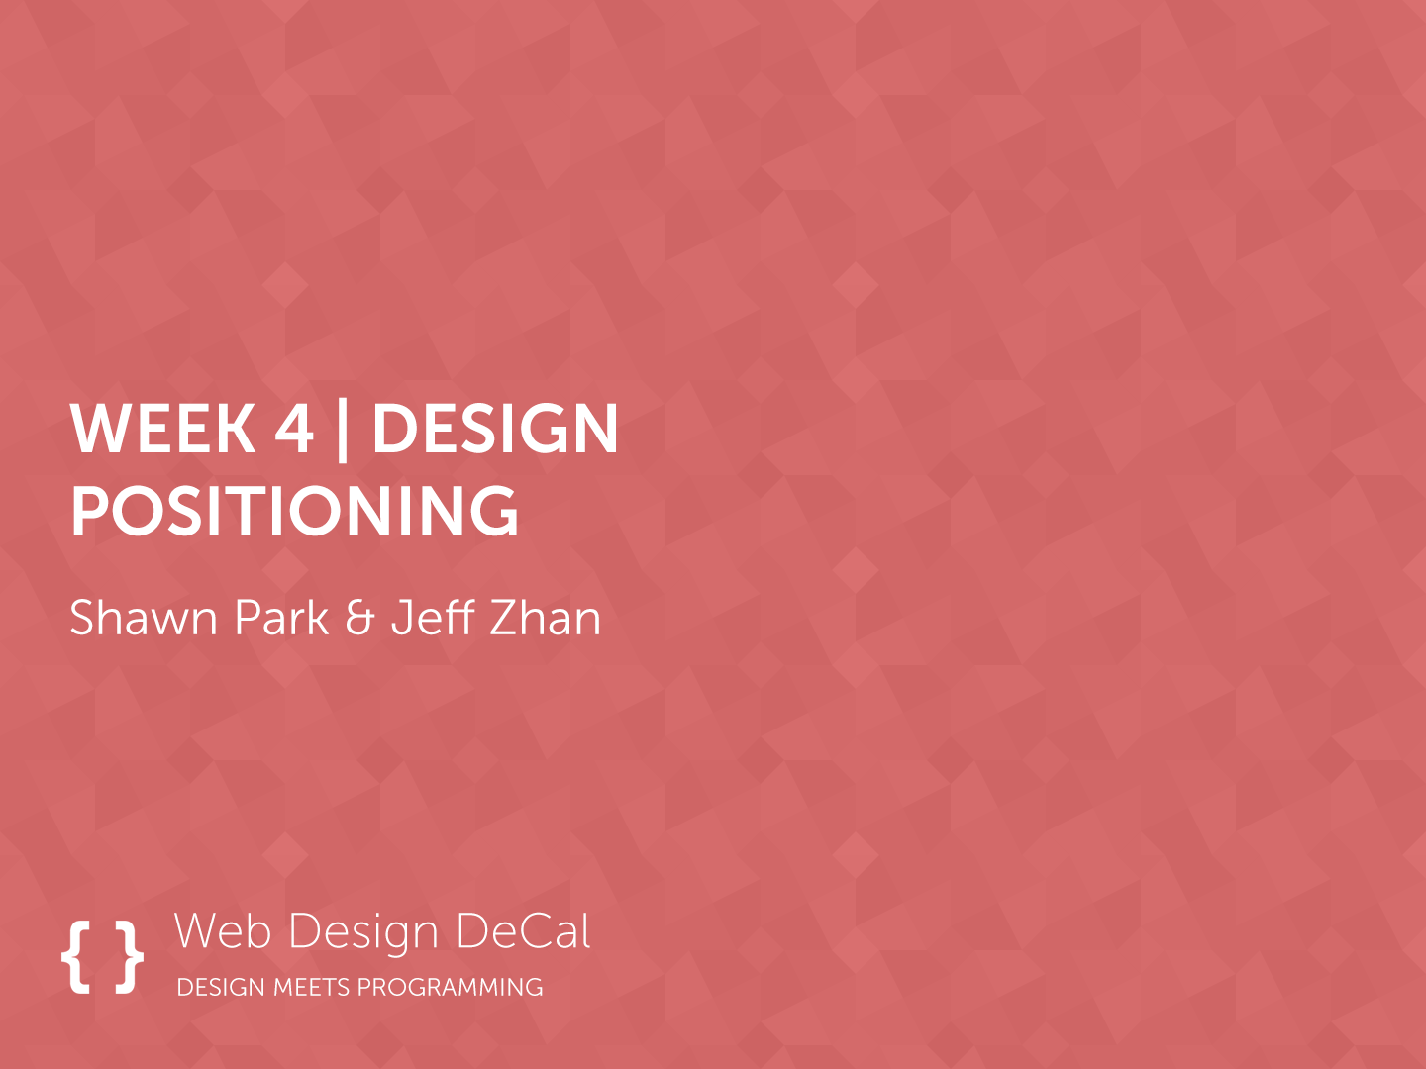

Slide 2
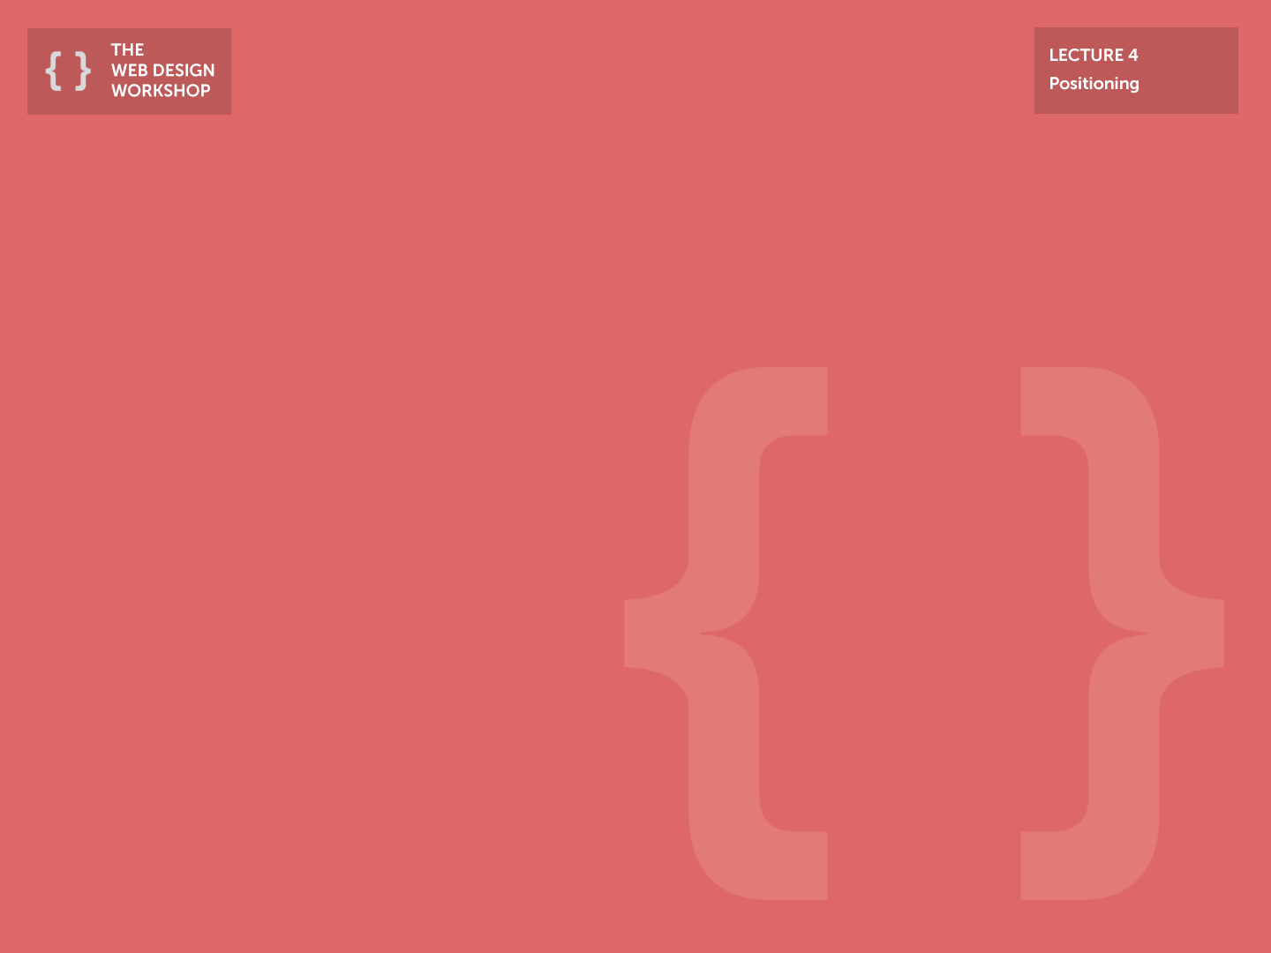
Previous Class
Macro-level spacing
Gives an element a structure & “room to breathe”
Padding: Spacing within an element
Margin: Spacing between elements
Micro-level spacing
Influences the legibility of text
Make sure your spacing makes your UI simple, but not barren.

Slide 3
Today
How should we create a layout of the website?
Positioning
Knowing where to place certain elements is a key to establishing strong emphasis

Slide 4
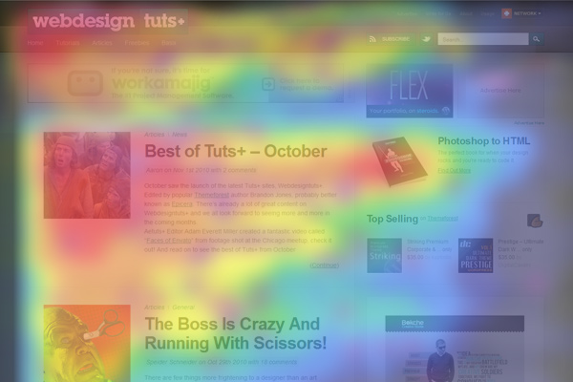
How we scan web pages

Slide 5
Introducing the F-Layout
Fundamental idea: We scan web pages from top-left to bottom-right
Therefore:
Design your websites by placing the most important elements on the top-left => top-right => center-left => so on…
Example: The Facebook Top Bar!

Slide 6
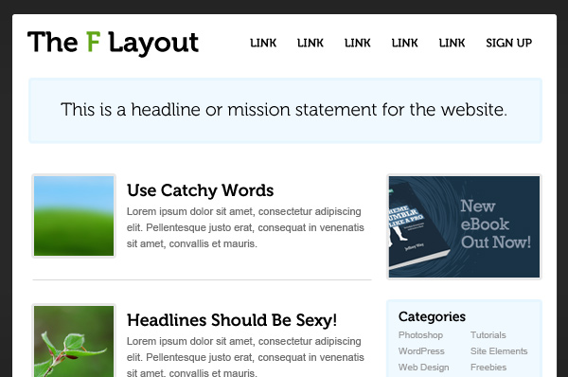

Slide 7
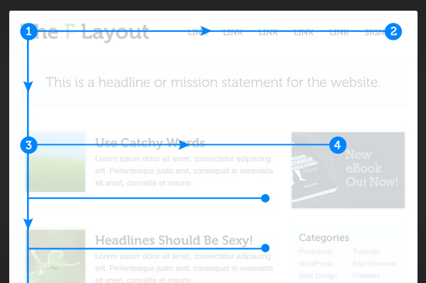

Slide 8
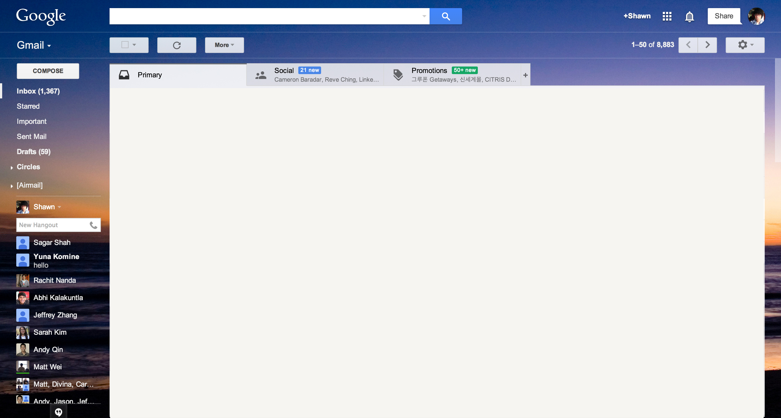
F-style Layout: Gmail

Slide 9
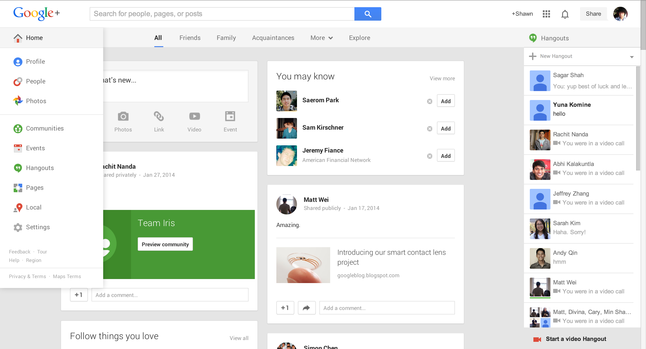
F-style Layout: Google+

Slide 10
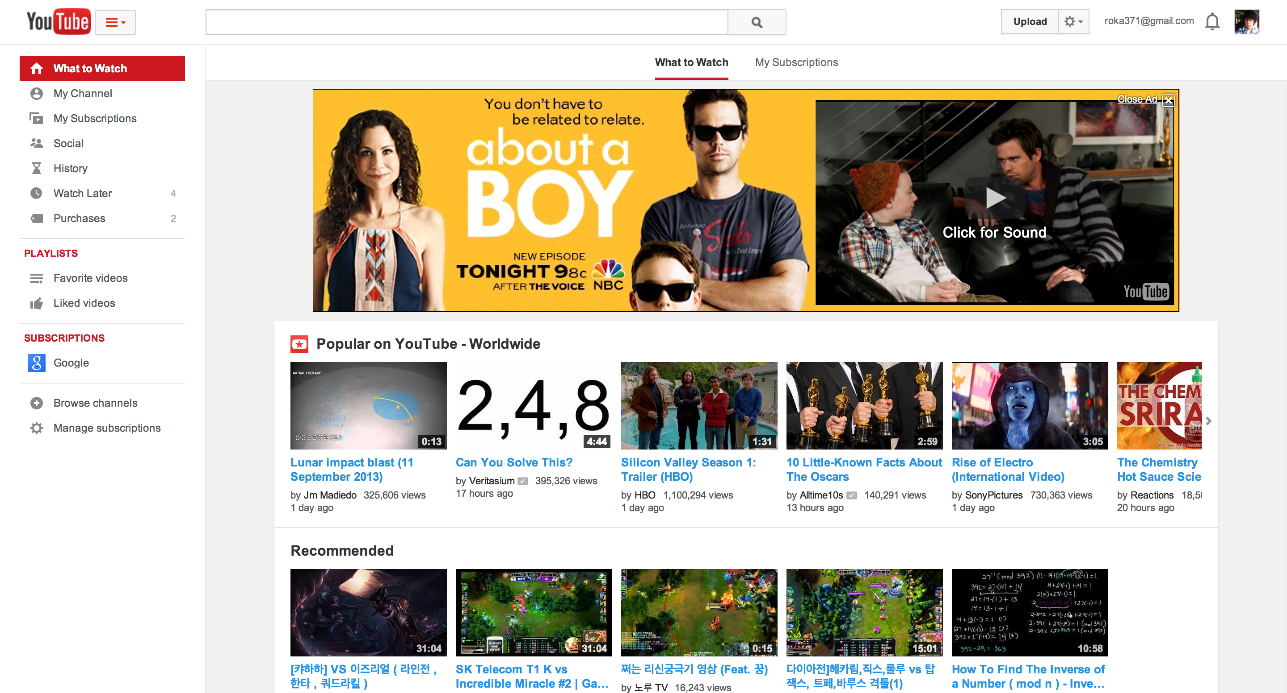
F-style Layout: YouTube

Slide 11
Exceptions to F-Layout Rule
F-Layout does not necessarily mean you must have a top bar with a logo on the top-left.
Layouts that feature images on the top with navigation on the bottom is becoming popular
Spotlight is on the image to create an emotional appeal

Slide 12
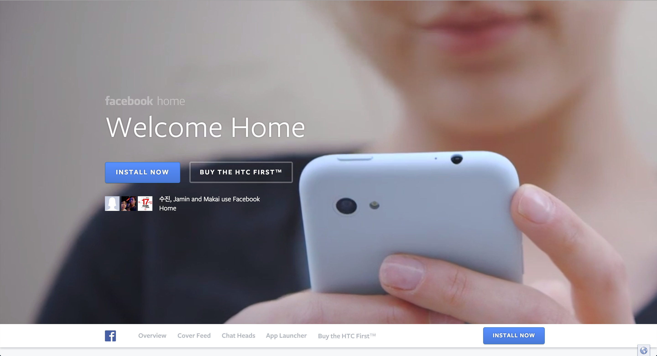
Bottom Navigation: Facebook Home

Slide 13
Website Layout
Website design is a top-down (inverted pyramid) process: design from general skeleton to specific
Navigation
Contentarea Skeleton
Specific Content

Slide 14
Navigation
Perhaps the most important element of your website
Almost all websites need this
A lot of website layouts stem from the position of a navigation
Two common methods:
Top bar (Ex. Facebook)
Sidebar (Ex. TweetDeck)
Usually used in conjunction with Position:fixed property

Slide 15
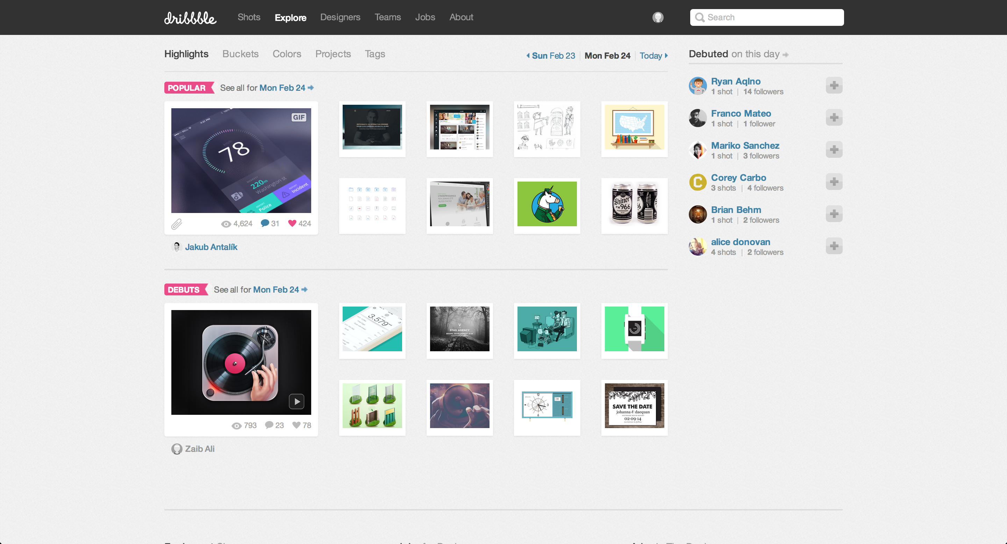
Top Navigation: Dribbble

Slide 16
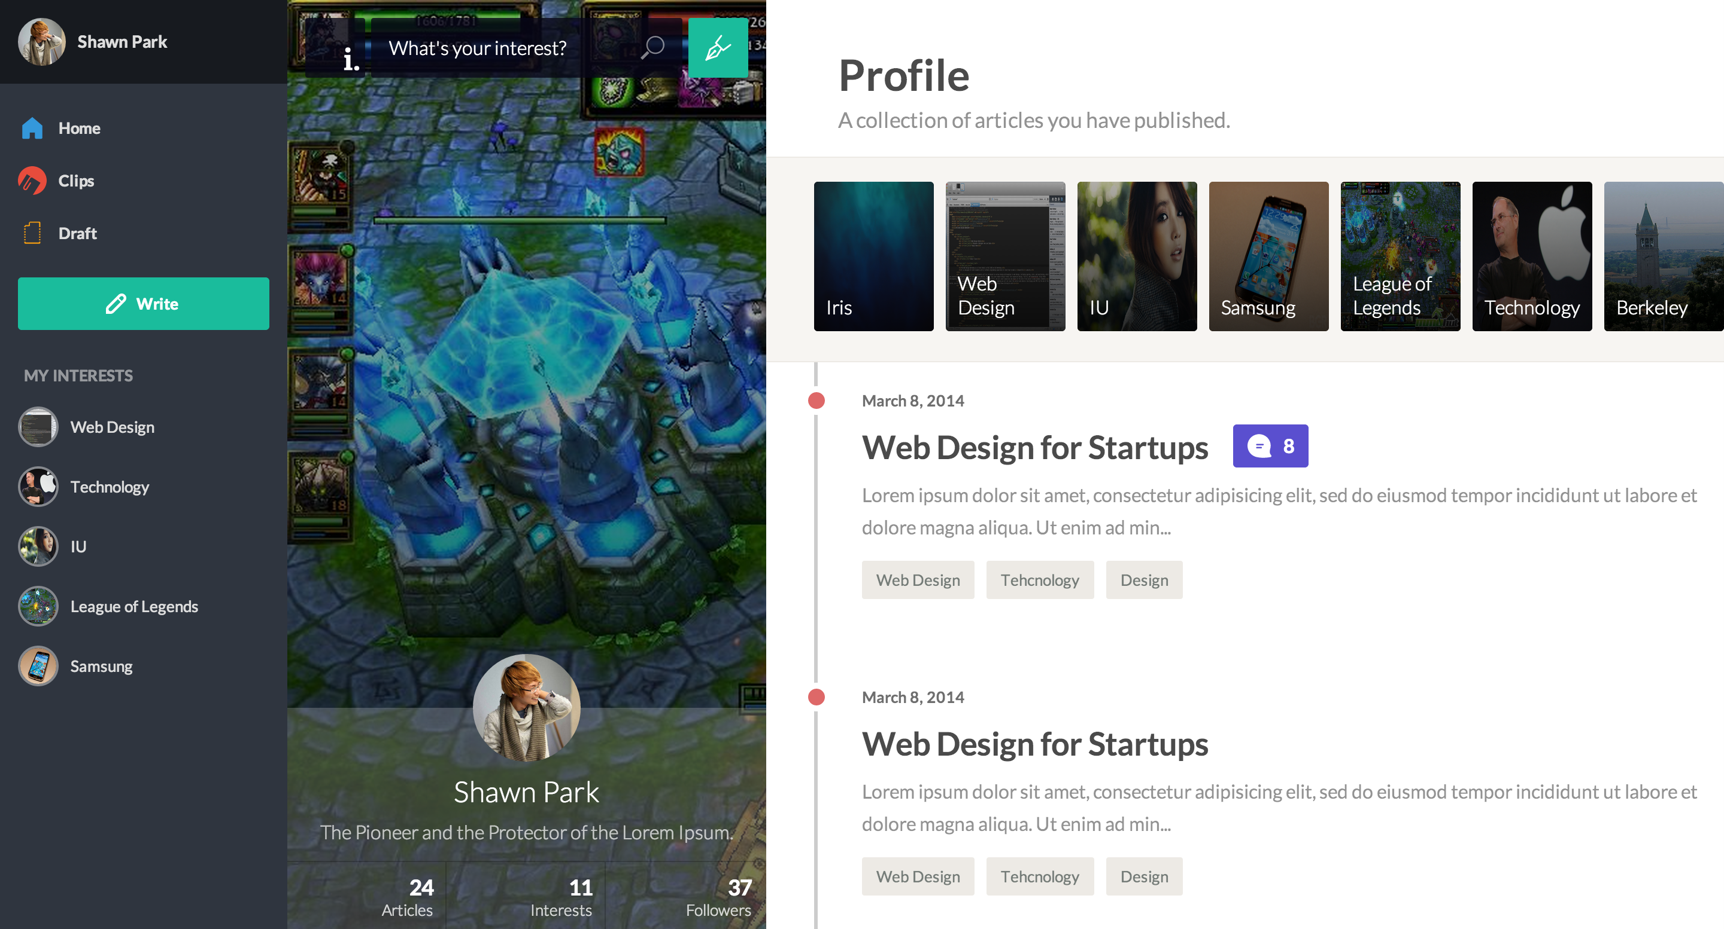
Side Navigation: Iris

Slide 17
Be Creative!
Your navigation doesn’t need to physically stick to the corner of the window.
Google Maps
New MySpace
Your navigation doesn’t need to be visible at all times
Medium

Slide 18
Contentarea
Contentarea is the area encapsulating your content
Important to create a skeleton for the area where all of your content will go in
Usually established through a centered 960px container

Slide 19
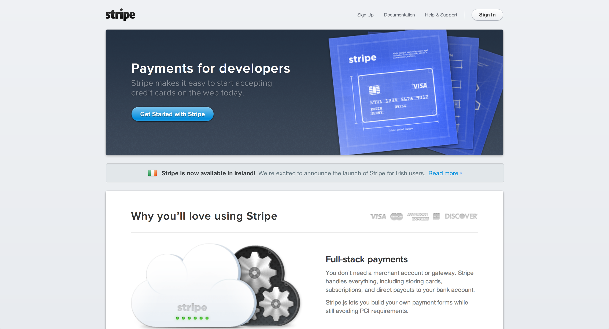
Contentarea: Stripe

Slide 20
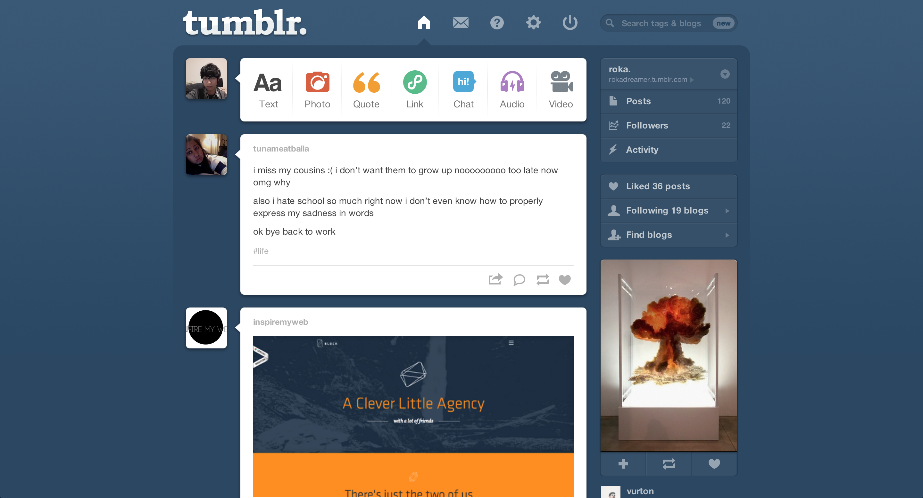
Contentarea: Tumblr

Slide 21
Specific Content
This is the area specific to your website – will highly vary depending on the purpose of your website
Personal & Promotional Websites: “Slides”
Blog & Application Websites: “Posts”
…limitless room for creativity!

Slide 22
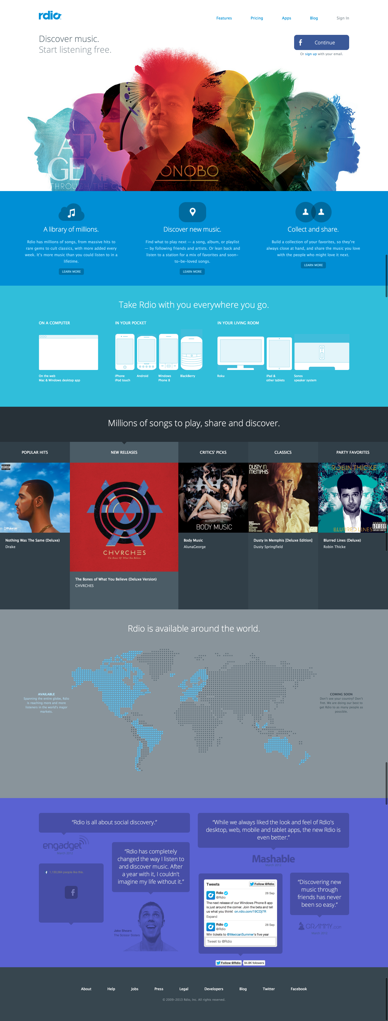
Content Style – “Slide”: Rdio

Slide 23
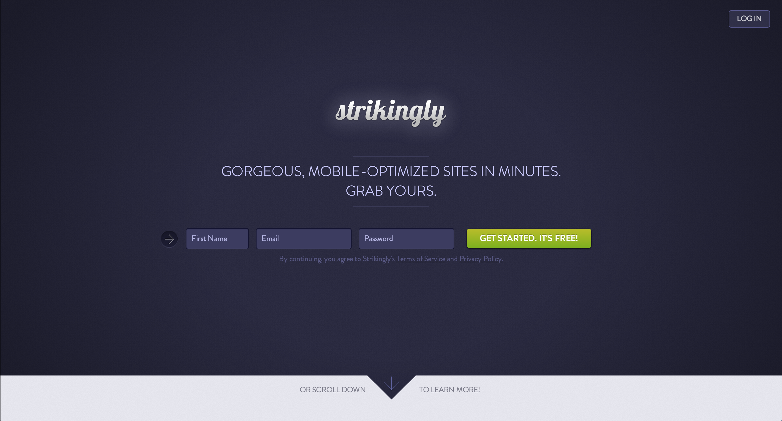
Content Style – “Slide”: Strikingly

Slide 24
Divide and Conquer
Think about your website into individual components, and design them separately in order.
Remember:
Horizontal stacking – Floats
Vertical stacking – Does automatically
On top of each other – position absolute
Each individual component will be its own div
Master this and you can take “any design” into code!

Slide 25
Exercise
What should you design first?

Slide 26
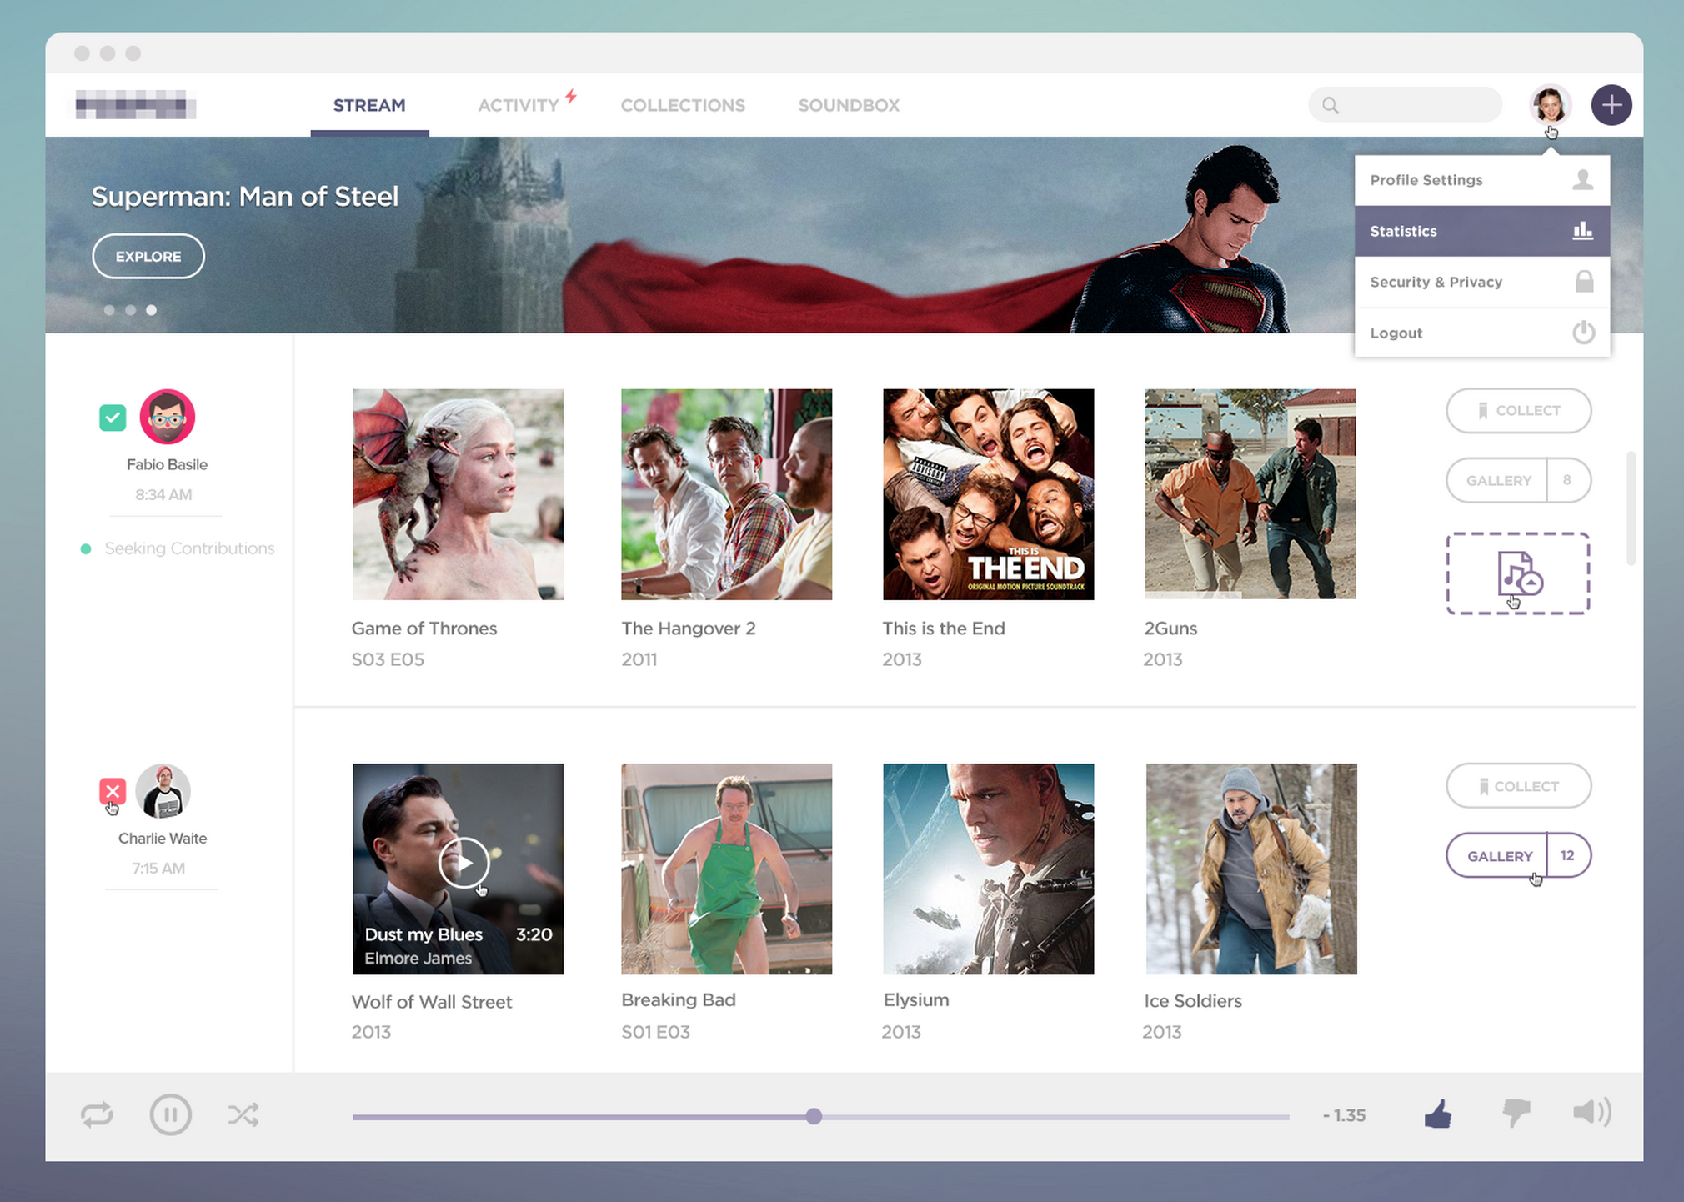

Slide 27
Structure
Logo
Navigation
Stream | Activity | Collections | Soundbox
Search
Search box | User | Add
Implementation
Horizontal => Floats

Slide 28
Structure
Cover
Content
Title
Explore
Some dots
Implementation
Cover (position: absolute)
Content (position: absolute)
Align vertically using divs

Slide 29
3 Parts: Sidebar, Gallery, Toolbar
A bit complicated if you think about making this responsive (viewable in multiple screen sizes)
Assume the size is fixed for this example only:
Horizontal stack => Floats

Slide 30
Sidebar
Thumbnail
Name
Date
Contribution
Content (4X)
Thumbnail
Title
Episode / Release Date
Toolbox
Collect
Gallery
Some music thing

Slide 31
Simple – just stack things vertically using divs
Horizontal stack => Floats

Slide 32
3 Parts: Controls, Progress Bar, Options
Horizontal stack => Floats
Controls (Horizontal stack => Floats)
Repeat
Play
Shuffle
Progressbar (Kinda complicated – you will do this for HW4!)
Options (Horizontal stack => Floats)
Like
Dislike
Volume

Slide 33
Single Visual Design
A fullscreen background image underneath with a plenty of spacing & simple typography overhead.
Single Visual Design is a trending design technique used in many websites recently
Used widely in landing page designs

Slide 34

Single Visual Landing Page: Numbrs

Slide 35
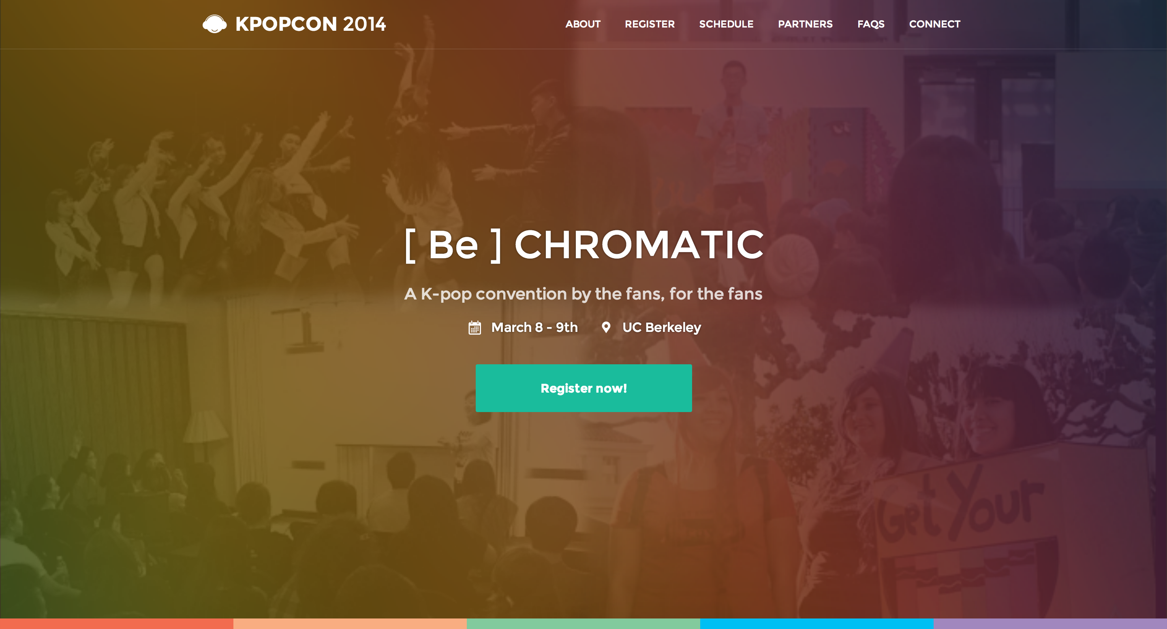
Single Visual Landing Page: Kpopcon

Slide 36
Review
F-style Layout: Place the most important element is top-left -> bottom-right order
General Layout Design: Start from general to specific
Navigation => Contentarea => Content
Divide and conquer: Think about your website as a sum of individual components as you turn it into a code
Single Visual Design: excellent way to provoke emotion for your landing page

